Slide 1
Financial Inclusion
Vivian Malta, IMF
IMF Flickr

Slide 2
What does financial inclusion entail?
Financial inclusion requires that a range of financial services—are accessible to and used by a wide population, importantly those who are traditionally underserved or excluded, including women, low-income individuals, and SMEs
Access to Financial Services:
Highlights the availability and reach of financial services for the population, regardless of location or economic status. It focuses on accessibility through financial branches, ATMs, agents, mobile money, and other digital platforms, making services easily obtainable within a reasonable distance.
Usage of Financial Services:
Focuses on how individuals and businesses use financial products to effectively manage their needs. It includes:
Transactions and payments. Conducting financial activities such as receiving salaries and paying bills.
Deposits and savings. Offering secure means to save for emergencies, opportunities, and future planning.
Credit. Receiving loans and credit for personal, educational, healthcare, or business purposes.
Insurance. Using insurance to mitigate health, life, and business risks.
Financial inclusion may encompass additional dimensions: quality, supporting users with financial literacy, protecting users, affordability.
Notes:
High quality: Focuses on providing financial services that meet consumer needs in a reliable, timely, and satisfactory manner.
Supporting users’ financial literacy: Empowers consumers with the knowledge to make informed decisions,
Protecting users, Ensures fair treatment of consumers by financial service providers, protecting them
from harm or exploitation through: Transparency, Privacy and data protection, and Grievance redressal mechanisms.
Affordable by focusing on ensuring the cost of accessing and using financial services is properly priced

Slide 3
Financial Health
Financial Health: measuring financial well-being outcomes
Financial health implies that individuals and households can
There are different variables that can reflect the state of an individual’s financial wellness
Manage everyday expenses
Withstand and recover from shocks
Progress towards financial goals
Exercise control and feel secure about finances
Liquid assets, such as cash and deposits
Wages and salaries
Gross disposable income
Debt service payments
Financial assets, such as debt securities
Household savings
Current transfers, such as tax credits
Insurance, such as medical and life plans
Short-term credit
Net worth
Nonfinancial assets, such as real estate
Household debt, including mortgage
Credit card use and balances
Foreign exchange assets and liabilities
Insurance,
Pensions
Nonperforming loans
Refinancing activity
Digital payments
Notes:
Beyond financial inclusion, the outcome of “good financial inclusion and policies, enabling inclusive growth
Complex task to acquire data.
From a macroeconomic perspective we see value on supply-side data t support such measurement
Compiling complementary data bases, FAS, FSIs and MFS HH sector
+ Developing new data dimensions

Slide 4
Financial Inclusion and Macroeconomic Implications

Slide 5
Financial Inclusion: A Catalyst for Inclusive Growth
Financial inclusion serves as a catalyst not only for economic growth but crucially for inclusive growth, supporting the reduction of poverty and inequality
Providing individuals and businesses with access to capital, allowing them to invest in education, healthcare, and income-generating activities.
Helping underserved groups smooth their consumption, manage their financial risks, and invest in the future – thereby reducing poverty and inequality.
Making available the access and use of financial services to a broad spectrum of society, especially under-served groups including women; thus enabling them to benefit from economic growth.
Notes:
Inclusive growth. The concept of inclusive growth is founded on the principle that wealth generation, economic liberty, and equal chances can coexist (Agarwal R.). The OECD (2018) describes it as growth that is evenly distributed throughout society.

Slide 6
Financial Inclusion and Some Macro-economic Implications
Empirical literature suggests beneficial effects on labor markets and fiscal outcomes.
Labor market implications: Spur entrepreneurship, job creation, and income generating activities growth (Beck and Levine, 2018)
In particular: access to financial services helps women enter the labor market, either by fostering entrepreneurship or enabling the transition from unpaid domestic work to paid employment (CGAP, 2021).
Fiscal Policy: tax base and taxable income (revenue), target social spending effectively (expenditure) (Mathai et al., 2020)
Women’s financial inclusion is associated with better outcomes in human capital, such as improved daughters’ education (Chiapa et al. 2015).
Notes:
Target social spending:
Direct Transfers: governments can implement direct cash transfer programs more efficiently. By using bank accounts or mobile wallets, funds can be disbursed quickly and securely to those in need.
Empowerment of Marginalized Groups: Financial inclusion often focuses on marginalized populations, such as women or low-income individuals. Targeting social spending to these groups can enhance their economic stability and overall community welfare
3. Data-Driven Insights: Financial inclusion enables the collection of data on individuals' income, spending patterns, and financial behaviors. This data helps policymakers identify which demographics or regions require more support.
4. Feedback Mechanisms: Example: A mobile money service collects data on transaction patterns and usage frequency among beneficiaries of a social program (e.g., cash transfers). Feedback: Service providers can analyze this data to understand how recipients are utilizing funds, adjusting the program based on whether beneficiaries are using funds for essential needs (like food and education) or if they are saving them for future use. Enabling transition:
To be paid in the formal sector.
Reduced Barriers: With financial resources, women can afford transportation, childcare, or other costs associated with seeking paid employment, making it easier to transition into the labor market.
Work Hours: Financial independence may allow women to negotiate for more flexible work hours, accommodating both professional commitments and domestic responsibilities.
Key Channels of Impact of Financial Inclusion and Improved daughters’ education
Empowerment and Decision-Making:
Increased Household Income:
Investment in Education: Women with financial resources are more likely to invest in their children's education, including school fees, uniforms, and materials.
Improved Financial Literacy: Access to financial services often comes with education on managing finances. Women who improve their financial literacy may prioritize education and savings for their children's future.
Social Norms and Role Modeling: As women become financially independent, they challenge traditional gender norms. This shift can encourage families to support daughters' education, as mothers serve as role models demonstrating the value of education.

Slide 7
Financial Inclusion and Monetary Implications
Literature indicates that a higher level of financial inclusion positively impacts the effectiveness of monetary policy (Mehrotra and Yetman, 2014).
Greater financial inclusion will lead to (Demirguc-Kunt et al. 2017)
More consumption smoothing
More savings in the form of bank deposits
Monetary policy operations will be affected along some dimensions
(Dabla-Norris et al., 2015).
Smaller interest rate adjustments needed in response to shocks
Stronger case for using interest rates as the primary policy tool
Notes:
Positive effect of higher level of financial inclusion on the effectiveness of monetary policies (Mehrotra and Yetman, 2014).
As an expanding number of people become part of the formal financial sector, the effectiveness of central banks’ use of the interest rate as a primary policy tool increases (Dabla-Norris et al., 2015).

Slide 8
Barriers to Financial Inclusion

Slide 9
Economic and Structural Barriers
Lower earnings: Wage gaps and informal work reduce savings and loan eligibility.
Job informality: Limits access to formal employer-linked banking systems; lack of proof of income.
Women's lower asset ownership can affect their ability to secure credit, as banks typically require collateral.
Credit information gaps: Women often lack credit histories due to limited formal financial engagement.
Notes:
Why Formality is good: 1. Payroll Accounts: Banks may offer accounts specifically designed for employees to receive their salaries directly, which can facilitate easier management of finances.
Credit Opportunities: Employees may have access to loans, credit cards, or other financial products that are tailored for them as part of their employment package.
Employer Contributions: Some systems allow for employers to make direct contributions to savings accounts, retirement funds, or other financial products on behalf of employees.
Financial Education: Employers may partner with financial institutions to provide financial literacy programs to help employees understand banking products and services.
Access to Benefits: Employees may gain access to additional benefits like insurance, investment options, or special interest rates on loans through their employer.
Enhanced Trust: Having a banking relationship linked to employment can build trust between the financial institution and the employee, as the employer may vouch for the employee's stability.

Slide 10
Legal and Social Norms
Asset Ownership Restrictions: Legal/customary laws limit women's rights to own or inherit property, undermining access to credit.
Lack of Legal Protections: Many countries lack anti-discrimination laws in finance and employment.
Social norms regarding women’s financial independence; need for male approval.
Self-Perception and Confidence Gaps: Women are less likely to apply for loans.
Notes:
Source: IMF WP/18/38; Kolovich & Newiak (2024), Ch. 2 & 15

Slide 11
Digital Financial Services
By relying on alternative data rather than credit histories or formal collateral, fintech could/can better evaluate female borrowers who are otherwise marginalized by traditional systems.
However, some barriers to digital financial services are:
Lower Digital Literacy: Women less likely to use mobile internet or fintech.
Access to Devices: Limited ownership of smartphones or private tech access.
Fintech Bias: Algorithms may replicate biases in credit access.
Notes:
IMF F&D Magazine (2022); Kolovich & Newiak (2024), Ch. 18
Utility Payment History: Data on timely payment of utilities (electricity, water, internet) can indicate financial responsibility.
Rental Payment History: Consistent rent payments can serve as a sign of creditworthiness.
Mobile Phone Payment Records: Regular payments for mobile services can provide insights into a borrower's reliability.
Social Media Activity: Analysis of social media behavior might reveal patterns related to financial stability or community involvement.
E-commerce Transactions: Purchase history from online platforms can help assess spending habits and financial behavior.
Employment History: Data regarding job stability, income levels, and career progression can be useful in assessing creditworthiness.
Education and Professional Qualifications: Information about educational background and professional certifications can help evaluate potential earning capacity.
Digital Footprint: Online behavior, such as website visits or app usage, can provide insights into lifestyle and spending habits.

Slide 12
Policy Options

Slide 13
Economic and Structural Barriers
Lower earnings: Wage gaps and informal work reduce savings and loan eligibility.
Job informality: Limits access to formal employer-linked banking systems; lack of proof of income.
Women's lower asset ownership can affect their ability to secure credit, as banks typically require collateral.
Credit information gaps: Women often lack credit histories due to limited formal financial engagement.
Notes:
Why Formality is good: 1. Payroll Accounts: Banks may offer accounts specifically designed for employees to receive their salaries directly, which can facilitate easier management of finances.
Credit Opportunities: Employees may have access to loans, credit cards, or other financial products that are tailored for them as part of their employment package.
Employer Contributions: Some systems allow for employers to make direct contributions to savings accounts, retirement funds, or other financial products on behalf of employees.
Financial Education: Employers may partner with financial institutions to provide financial literacy programs to help employees understand banking products and services.
Access to Benefits: Employees may gain access to additional benefits like insurance, investment options, or special interest rates on loans through their employer.
Enhanced Trust: Having a banking relationship linked to employment can build trust between the financial institution and the employee, as the employer may vouch for the employee's stability.

Slide 14
Legal and Social Norms
Asset Ownership Restrictions: Legal/customary laws limit women's rights to own or inherit property, undermining access to credit.
Lack of Legal Protections: Many countries lack anti-discrimination laws in finance and employment.
Social norms regarding women’s financial independence; need for male approval.
Self-Perception and Confidence Gaps: Women are less likely to apply for loans.
Notes:
Source: IMF WP/18/38; Kolovich & Newiak (2024), Ch. 2 & 15

Slide 15
Digital Financial Services
By relying on alternative data rather than credit histories or formal collateral, fintech could/can better evaluate female borrowers who are otherwise marginalized by traditional systems.
However, some barriers to digital financial services are:
Lower Digital Literacy: Women less likely to use mobile internet or fintech.
Access to Devices: Limited ownership of smartphones or private tech access.
Fintech Bias: Algorithms may replicate biases in credit access.
Notes:
IMF F&D Magazine (2022); Kolovich & Newiak (2024), Ch. 18
Utility Payment History: Data on timely payment of utilities (electricity, water, internet) can indicate financial responsibility.
Rental Payment History: Consistent rent payments can serve as a sign of creditworthiness.
Mobile Phone Payment Records: Regular payments for mobile services can provide insights into a borrower's reliability.
Social Media Activity: Analysis of social media behavior might reveal patterns related to financial stability or community involvement.
E-commerce Transactions: Purchase history from online platforms can help assess spending habits and financial behavior.
Employment History: Data regarding job stability, income levels, and career progression can be useful in assessing creditworthiness.
Education and Professional Qualifications: Information about educational background and professional certifications can help evaluate potential earning capacity.
Digital Footprint: Online behavior, such as website visits or app usage, can provide insights into lifestyle and spending habits.

Slide 16
Bridging the Financial Inclusion Gender Gap: Policy Levers
Reform Legal Frameworks: Guarantee property and credit rights without discrimination.
Supervisory guidance for FIs to reduce biases
Invest in Digital and Financial Literacy: Launch targeted financial and digital education programs.
Proportionate and risk-based supervision of small and non-complex institutions striving to serve unserved and underserved customers, which are more often women than men.
Promote Gender Budgeting: Channel fiscal policy toward inclusive finance for women.
Improve Data Collection: Use sex-disaggregated data to monitor and tailor policy interventions.
Support Inclusive Fintech: Promote alternative credit scoring models and mobile finance.
Improve access to digital infrastructure (mobile phones, high-speed internet, digital ID)
Notes:
Source: IMF Gender Strategy (2022); Kolovich & Newiak (2024), Ch. 15–18
This guidance reflects the need for proportionate risk-based regulation and supervision of small and non-complex institutions striving to serve unserved and underserved customers, which are more often women than men and who typically engage in small
transactions.

Slide 17
Financial Inclusion: Policy Levers
IMF AIV Country Examples:
Ethiopia: Digitalization, national IDs
Rwanda: Expanding access to land, credit, and digital financial services
Tanzania: Loan provisions, training for entrepreneurs, analysis of gender gaps in financial inclusion
Uganda: Credit registries to support female financial inclusion

Slide 18
Policy Interventions Studies

Slide 19
Harvard’s Gender Action Portal
A resource by Harvard Kennedy School Women & Public Policy Program
Explores intersectional research on gender equality
Incorporates a gender perspective into thought leadership & policymaking
Includes 324 studies by 850 researchers; covering 20 topics from 47 countries
Harvard’s GAP
Disclaimer: The findings of these studies are those of the authors and do not necessarily represent the views of the IMF, its Executive Board or IMF Management.

Slide 20
Policy Experiments: Harvard’s GAP
On Her Own Account: How Strengthening Women’s Financial Control Impacts Labor Supply and Gender Norms
Savings Constraints and Microenterprise Development: Evidence from a Field Experiment in Kenya
The Economic Returns to Social Interaction: Experimental Evidence from Microfinance

Slide 21
1) “On Her Own Account”
Target: Women in rural Madhya Pradesh, India, who were eligible for the national workfare program (MGNREGS).
The Goal: To determine if simply having an account is enough, or if women need both direct ownership of their wages and technical agency to overcome household barriers to working.
The Intervention: A Randomized Controlled Trial (RCT) with four groups. The most effective "high-intensity" group received:
Individual Accounts: Assistance in opening a private bank account.
Direct Deposit: Legal redirection of their government wages into that private account (rather than a shared household account).
Technical Training: A 2-hour "hands-on" session. Researchers took women to local banking kiosks and taught them how to use biometric smartcards, check their balance privately, and withdraw cash without needing a male relative to act as an intermediary.

Slide 22
1) “On Her Own Account”
Key Results: Only the women who received the Training + Direct Deposit significantly increased their labor supply and developed more liberal gender norms.
Explanation: Direct control over money changes the power dynamic at home. When a woman knows how to manage her money privately, the "cost" of working decreases because her earnings are shielded from being "taxed" or controlled by other family members. This proves that financial literacy and privacy are just as important as financial access.

Slide 23
2) “Savings Constraints & Microenterprise ”
Target: Daily-income earners in rural Kenya, specifically female market vendors and male bicycle taxi drivers.
The Goal: To test if a "safe place to keep money" is a more significant barrier to business growth than the cost of credit or interest rates.
The Intervention: Researchers partnered with a local village bank to provide:
Subsidized Entry: They paid the $6 account opening fee and provided the minimum balance for the treatment group.
Intentional Friction: The accounts paid 0% interest and actually charged a $0.50 withdrawal fee.
Usage Tracking: Researchers monitored daily deposits to see if participants used the bank to store small daily surpluses that would otherwise be spent or given away.

Slide 24
2) “Savings Constraints & Microenterprise ”
Key Results: Female market vendors used the accounts heavily and increased their business investments by nearly 40%. Men saw no significant change.
Explanation: Women face high "social taxes"—constant pressure from their social network to lend out visible cash. The bank account acts as a shield, providing a socially acceptable excuse ("The money is in the bank") to refuse requests. This allows them to accumulate the "lumpy" sums of cash needed to buy inventory and grow their business.

Slide 25
3) “Economic Returns to Social Interaction ”
Target: New female microfinance clients in West Bengal, India.
The Goal: To determine if the social frequency of meetings (sitting together) builds enough trust to reduce loan defaults and create a mutual support network.
The Intervention: Researchers randomized the mandatory meeting schedules for newly formed groups of 10 women:
Weekly Meetings: Groups met 4 times a month to repay their loans.
Monthly Meetings: Groups met only once a month to pay the same total amount.
The Experiment: Both groups had the same loan terms; the only difference was how often they were forced to see each other. Researchers then tracked their interactions outside the meetings (visiting homes, sharing food) and their long-term repayment behavior.

Slide 26
3) “Economic Returns to Social Interaction ”
Key Results: Women who met weekly were three times less likely to default on future loans and shared much more business advice and childcare support.
Explanation: Frequent interaction builds "social collateral." When women know each other well, they are more willing to step in and help a peer who has a bad week. For policy makers, this suggests that the "social" part of microfinance isn't a byproduct—it's the engine that makes the lending safe and the community more resilient.

Slide 27
Data

Slide 28
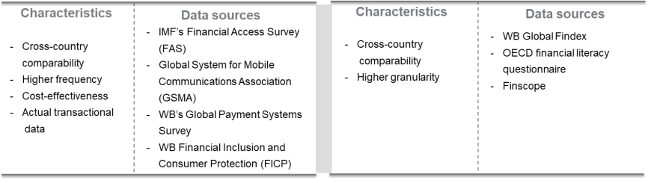
Financial inclusion: How is it measured?
Supply Side Data
Demand Side Data
Notes:
Demand-Side Data are collected directly from households or firms through surveys. These data capture the experiences, needs, and satisfaction levels of users with financial services, often including users’ perceptions of those services. Detailed but low frequency
Supply-Side Data are sourced from FSPs through administrative or supervisory sources. The strength of supply-side data lies in their ability to provide actual transactional data on the availability and usage of financial services. These data are typically more cost-effective to collect and can be made available more frequently than demand-side data.

Slide 29
Financial Access – Demand Side Data
Account ownership (% of population ages 15+)
Source: World Bank’s Findex
Notes:
Also available at the World Bank’s Gender Data Portal!

Slide 30
Mobile Accounts
Source: World Bank’s Findex
Notes:
The latest available data for Kenya, Malawi, Tanzania and Uganda is from 2024. For Rwanda, the most recent data is from 2017. WB has removed Ethiopia data in latest release of financial inclusion report
Key Features of a Mobile Money Account:
Digital Wallet: The mobile money account acts as a digital wallet where users can keep their funds securely and access them from their mobile phones.
Money Transfers: Users can send and receive money to and from other mobile money accounts or bank accounts, facilitating peer-to-peer transactions.
Bill Payments: Mobile money accounts often allow users to pay utility bills, school fees, and other services directly from their accounts.
Purchasing Goods and Services: Users can make payments for goods and services at merchants that accept mobile money, often through QR codes or SMS confirmations.
Access to Financial Products: Many mobile money accounts provide additional financial services, such as savings accounts, microloans, and insurance.
User-Friendly Interface: Transactions can typically be conducted via SMS, mobile apps, or USSD codes, making it accessible to users with varying levels of technology proficiency.
Security Features: Mobile money accounts usually incorporate security measures such as PIN codes, biometric authentication, and transaction alerts to protect users' funds.

Slide 31
Financial Usage: Borrowing
Borrowed any money (% of population ages 15+)
Source: World Bank’s Findex

Slide 32
Financial Access – Demand Side Data
Group Exercise: Exploring Findex data

Slide 33
Financial Usage: Savings
Saved using a savings club or a person outside the family (% of population ages 15+)
Saved at a bank or financial institution or using a mobile money account (% of population ages 15+)
*Data for 2024 except Rwanda (2017)
Source: World Bank Gender Data Portal
Notes:
savings clubs: While microfinance institutions help reduce the gender gap, they still do not fully close it, and informal financial systems (e.g., savings clubs) may not have risk management tools (financial protection), regulatory protection, limited services.

Slide 34
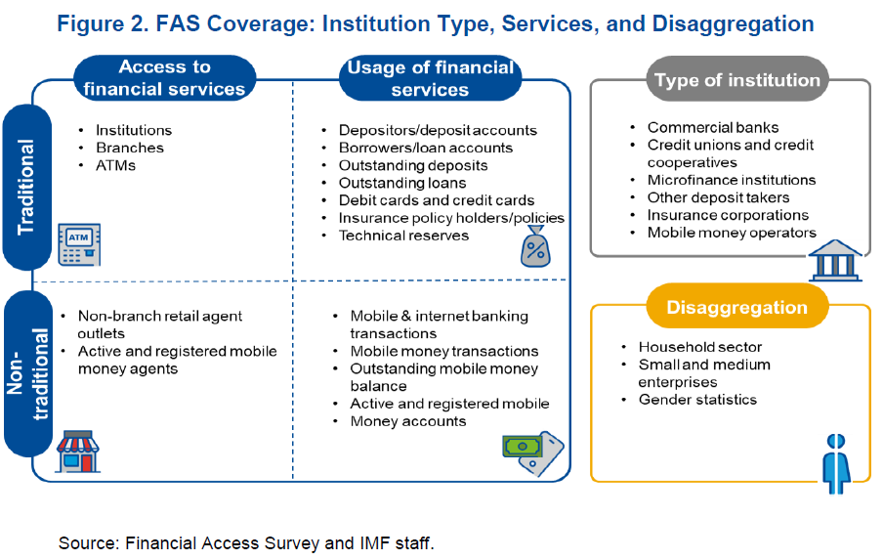
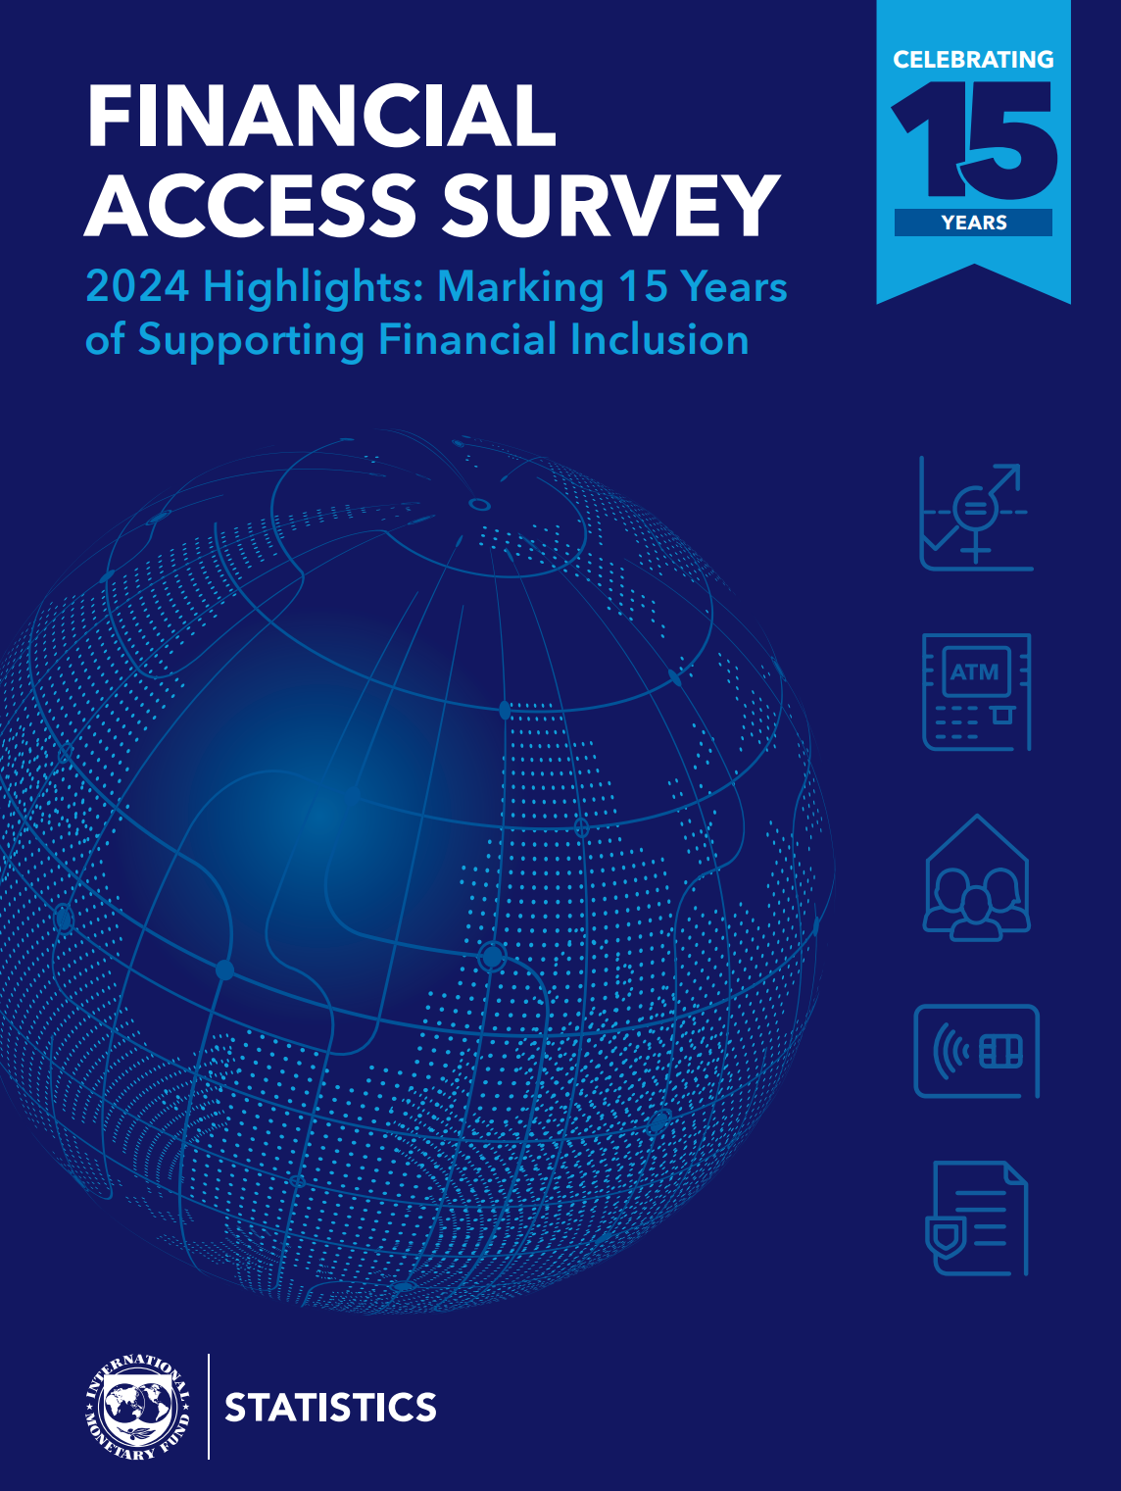
Financial Inclusion: The IMF Financial Access Survey
The Financial Access Survey (FAS) is the most extensive supply-side database for financial access and usage
Financial Access Survey - By Indicator - IMF Data
Notes:
Nearly complete global coverage.
Encompasses 192 economies—including 36 out of the 39 fragile and conflict-affected states (Annex I).
The dataset spans two decades (2004–2023)
The FAS comprises 121 series reported directly by participating economies and 70 estimated indicators.
Access points are tracked by 125 series, while usage of financial services is tracked by 106 series.
Thank authorities for their excellent FAS reporting and invite to make an extra effort to improve reporting of gender disaggregation
https://www.imf.org/en/News/Articles/2024/10/30/pr-24400-imf-releases-the-2024-financial-access-survey-results

Slide 35
FAS Series
The FAS comprises 121 series reported directly by participating economies, including 15 focused on access and 106 on the usage of financial services. The FAS covers a broad spectrum of types of financial institutions, with further data disaggregation, allowing for nuanced analysis.
Access to financial services. The FAS captures data on both traditional and non-traditional access points:
Traditional. Includes the number of institutions, branches (for all financial institutions except insurance corporations), and ATMs.
Non-traditional. Includes non-branch retail agent outlets, and both registered and active mobile money agent outlets.
Usage of financial services. The FAS offers extensive series on the usage of both traditional and non-traditional financial services:
Traditional services. Includes data on deposits and loans (number of accounts, account holders, and outstanding balances), debit and credit cards, and insurance (number of policyholders and policies, and outstanding values of technical reserves and annuities entitlements).
Non-traditional services. Covers mobile and internet banking (number and value of transactions) and mobile money (active and registered accounts, along with the number and value of transactions).

Slide 36
FAS Series
Type of Institutions. The FAS collects data from a wide range of institutions, including:
Commercial banks
Credit unions and cooperatives.
Microfinance institutions (both deposit taking and non-deposit taking)
Other deposit takers
Insurance corporations.
Mobile money operators.
Further data disaggregation. The FAS provides data disaggregated by relevant sectors and gender (male/female) for selected series and financial institutions.
deposit and loan series for commercial banks and credit unions and cooperatives include values for both households and SMEs
Household data are further broken down by gender.

Slide 37
FAS Indicators
The FAS also include 70 indicators—17 on financial access and 53 on usage—normalized by the size of the adult population, land area, and GDP in addition to the 121 series directly reported by participating economies.
Indicators on access to financial services.
Traditional access. Measures the number of branches and ATMs per 1,000 km² and per 100,000 adults, as well as the number of insurance corporations per 100,000 adults.
Non-traditional access. Includes non-branch retail agents and the number of registered and active mobile money agents per 1,000 km2 and per 100,000 adults.
Indicators on the usage of financial services.
Traditional usage. Covers data on the number of deposit accounts, depositors, loan accounts, and borrowers per 1,000 adults. Additional indicators cover outstanding deposits and loans (normalized by GDP); as well as the number of life and non-life insurance policies, and credit and debit cards per 1,000 adults.
Non-traditional usage. Covers the number of mobile and internet banking transactions, mobile money transactions, and active and registered mobile money accounts per 1,000 adults. Indicators on the value of mobile and internet banking transactions, and mobile money transactions, normalized by GDP are also available.
Disaggregated usage indicators: Deposit and loan indicators for commercial banks are further broken down by SMEs and households, with gender disaggregated data for the household sector. Microfinance indicators on borrowers and loan accounts are also disaggregated by gender.

Slide 38
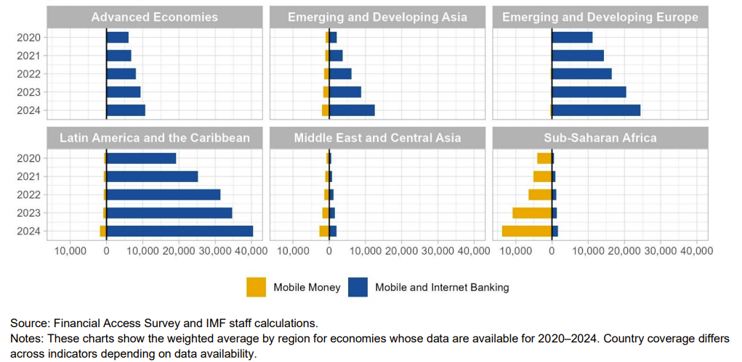
Mobile money is playing a transformative role in expanding access to finance in SSA.
FAS

Slide 39
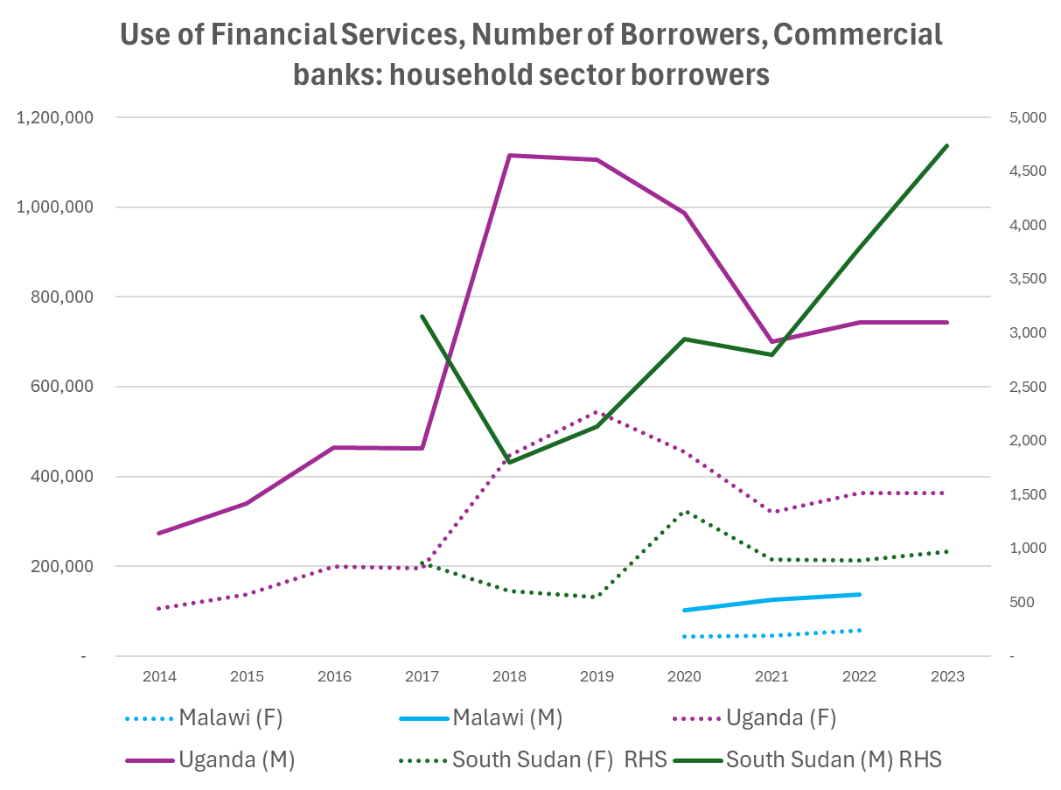
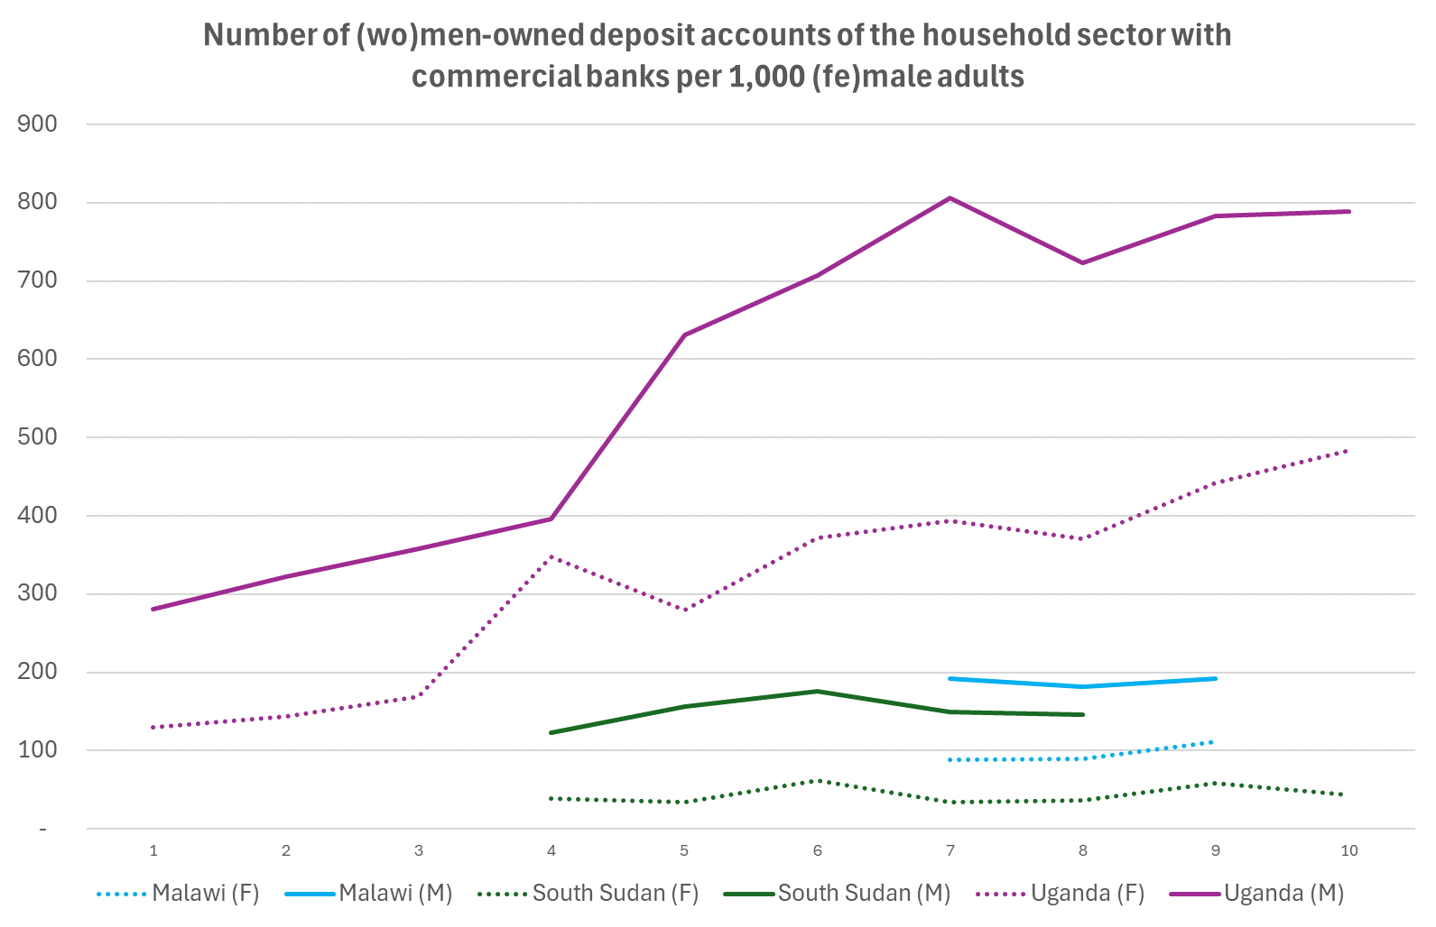
IMF’s FAS data
Source: IMF Financial Access Survey
Notes:
Missing Eritrea, Malawi, Tanzania.
With data:
Ethiopia
Kenya
Malawi
Rwanda
South Sudan
Tanzania
Uganda
In bold: gender-disaggregated data available

Slide 40
IMF’s FAS data
Use of Financial Services, Number of Borrowers, Commercial Banks; Household Sector Borrowers
No. of Deposit Accounts of the Household Sector with Commercial Banks, per 1,000 Adults, by Gender
Source: IMF Financial Access Survey
Notes:
Missing Eritrea, Malawi, Tanzania.
With data:
Ethiopia
Kenya
Malawi
Rwanda
South Sudan
Tanzania
Uganda
In bold: gender-disaggregated data available

Slide 41
Financial Access – Supply Side Data
Group Exercise: Exploring FAS data

Slide 42
Concluding Remarks

Slide 43
Concluding Remarks
Financial inclusion for underserved groups, particularly women, is crucial for economic development and inclusive growth, contributing to the reduction of poverty and inequality.
To develop data to adequately support evidence-based policy, it is of key relevance to keep in perspective the macroeconomic implications of financial inclusion.
Need to increase FAS data availability (gender-disaggregated): IMF liaises with Central Banks
There are several policy options for improving financial inclusion.

Slide 44
Thank you! Get in touch: vmalta@imf.org

Slide 45
Financial Inclusion: Policy Levers
Strengthen implementation of legal frameworks: Ensure equal property, inheritance, and contractual rights are enforced in practice.
Digital and financial literacy: Targeted financial and digital education programs.
Tailor regulatory and supervisory requirements to size, complexity, and risk profile of providers for underserved customers, while maintaining financial integrity and consumer protection
Improve data collection: Use sex-disaggregated data to monitor and tailor policy interventions in supervision, fiscal targeting, and program evaluation.
Support inclusive fintech: Promote alternative credit scoring models and mobile finance.
Improve access to digital infrastructure (mobile phones, interoperable payment systems, high-speed internet, digital ID)
Notes:
Source: IMF Gender Strategy (2022); Kolovich & Newiak (2024), Ch. 15–18
This guidance reflects the need for proportionate risk-based regulation and supervision of small and non-complex institutions striving to serve unserved and underserved customers, which are more often women than men and who typically engage in small
transactions.

